Slide 1
Lecture 7 Optimization & Search
CS582
Machine Learning: Getting Computers
to Program Themselves
“Discovering the Learning Dynamics of the Laws of Nature”
Dr. Emdad Khan
ekhan@mum.edu
Dept. of Computer Science
Maharishi University of Management
Nov, 2018

Slide 2
Optimization
In most algorithm we have seen so far, we have used some sort of optimization e.g. determine optimum value of weight vector W* to do classification or regression.
We have tried to do so by minimizing some error function – e.g. e = ½ Sum [y – t]^2.
We have shown that Gradient Descent is a good way to help minimize error.
We have used all above for continuous functions.

Slide 3
Optimization and Search
What happens when we would need to deal with discrete functions?
Discrete system does not have derivatives.
So, we cannot use the algorithms we have used so far which are focused on continuous systems.
So, we would need to think about some new approaches.
For discrete systems, Optimization is called Search i.e. Optimization problems becomes a Search Problem.
In this lecture we will focus on algorithms for Search i.e. Optimization for Discrete systems.

Slide 4
Search and AI
AI Community started looking into the search (discrete optimization) problem since early 1960s.
Discrete Optimization is an important field of Theoretical Computer Science.
Complex Discrete Optimization (i.e. search) problems are NP Complete problems (e.g. Traveling Salesman problem).
Problem solving Agents (including Intelligent Agents) are usually used to address search problems.
So, we will briefly cover Problem Solving Agents, NP and NP-Complete problems.

Slide 5
Problem-solving agents
The problem-solving agent is one kind of goal-based agents, it decides what to do by finding a sequence of actions that leads to a desirable states (goals).
State space : the set of all states which can be reached by sequence of actions. A finite state space can be represented by a graph ( vertex : state and edge : action)
Goal states : a subset of the state space, which the agent want to reach.
Initial state : the current state of the agent.

Slide 6
Example:
On holiday in Miami.
Flight leaves tomorrow from Paris to San Francisco.
Formulate goal:
  be after 4 days in Miami
Formulate problem:
  states: various cities
  actions: drive between cities
Find solution:
  sequence of cities, e.g., San Francisco, Los Angeles, Phoenix, Dallas, Miami.

Slide 7
Agents
An agent is anything that can be viewed as perceiving its environment through sensors and acting upon that environment through actuators
Human agent:
eyes, ears, and other organs for sensors;
hands, legs, mouth, and other body parts for actuators
Robotic agent: cameras and infrared range finders for sensors; various motors for actuators
١٤٤٨/٠٥/٢٩

Slide 8
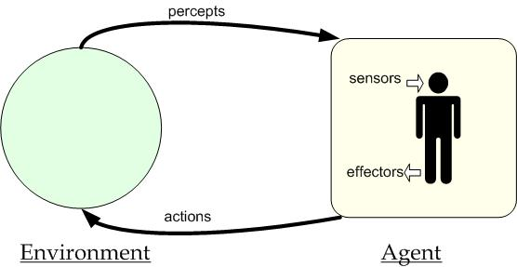
Agents
١٤٤٨/٠٥/٢٩

Slide 9

Agents and environments
The agent function maps from percept histories to actions:
[f: P* → A]
The agent program runs on the physical architecture to produce f
agent = architecture + program
١٤٤٨/٠٥/٢٩

Slide 10
Simple Problem-solving agents : environment type
Environment type : static (the problem is formulated and solved without paying any attention to the change of the environment).
The environment is observable : the initial state is assumed known (it is easiest if the environment is observable).
The environment can be viewed as discrete since the actions at each state can be enumerated.
The environment is deterministic (each action leads to a unique state).

Slide 11
PEAS
PEAS: Performance measure, Environment, Actuators, Sensors
Consider, e.g., the task of designing an automated taxi driver:
  Performance measure
  Environment
  Actuators
  Sensors

Slide 12

Schematic diagram of a Model-based reflex agents
A model-based reflex agent. It keeps track of the current state of the world using an internal model and takes actions accordingly.

Slide 13

Goal-based agents
A goal-based agent. It keeps track of the current state of the world using an internal model as well as a set of goals it is trying to achieve. It then chooses an action that leads to the achievement of the goal.

Slide 14

Utility-based agents

Slide 15

Learning agents
A general Model of Learning Agent

Slide 16
Intelligent Agent Applications
There are many applications: we can group them in 2 Major classes –
  Software &
  Hardware / software
Software: RPA – Robot Process Automation : Workflow and Administrative Management, Mail & Messaging, Electronic Commerce, E-Learning, and many more
Hardware / Software: Manufacturing, Welding, Material
Handling, Packaging, Drilling, Cleaning, Routing, Medical ….

Slide 17
Application Example
Robotic Process Automation – RPA
https://www.youtube.com/watch?v=xW95yb6J1eU

Slide 18
A well-defined problem and solutions
A well-defined problem is defined by some components
  initial state : a given current state.
  state space : the set of all states reachable from the initial state with the successor function.
  A path in the state space is a sequence of states connected by a sequence of actions {(action, successor)}.
  goal states : a subset of the stat space. The goal test determines whether a given state is a goal state.
  A path cost function that assigns a numeric cost to each path (the problem solving agent chooses a cost function that reflects its own performance measure).
  A solution to the problem is a path from the initial state to a goal state. Solution quality is measured by the path cost function, and the optimal solution is the lowest path cost among all solutions.

Slide 19

Example: The 8-puzzle
states? locations of tiles
actions? move blank left, right, up, down
goal test? = goal state (given)
path cost? 1 per move
[Note: optimal solution of n-Puzzle family is NP-hard]

Slide 20
Objectives
To describe a variety of search algorithms and show how search tree would be traversed using these algorithm.
To use the different search in problem solving.
To discuss advantages and limitation of these search algorithms.

Slide 21
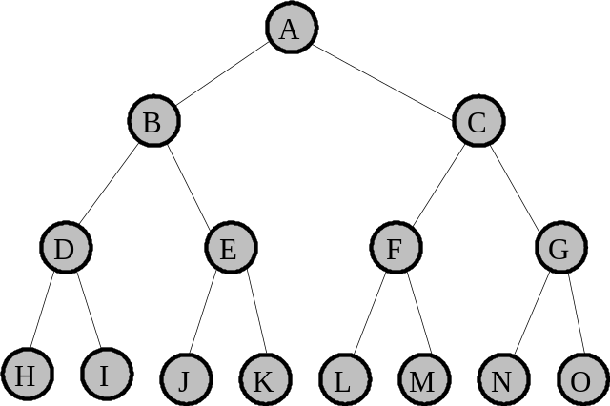
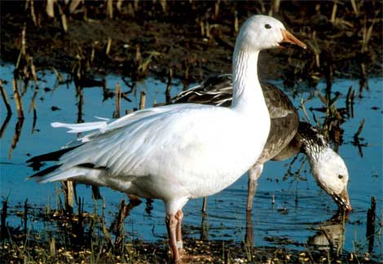
What is Searching in AI?
In computer science, a search algorithm, is an algorithm that takes a problem as input and returns a solution to the problem, usually after evaluating a number of possible solutions.

Slide 22
P versus NP problem:
Not Part of the Course – Just Food For Thought
(Easy for those who took Algorithms)
Notes:
Prepared by Dr. Zakir H. Ahmed

Slide 23
P versus NP problem
Number 1 Open Problem in Computer Science (#1 Millennium Prize Problem - US $1M)
What is P?
What is NP?
What is NP Complete?
What is NP Hard?
Is p = NP?
Notes:
Prepared by Dr. Zakir H. Ahmed

Slide 24
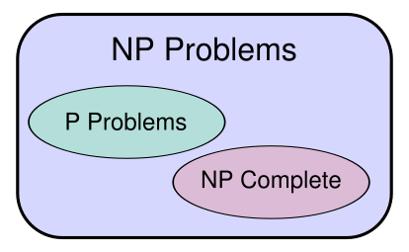
P versus NP problem
Notes:
Prepared by Dr. Zakir H. Ahmed

Slide 25
P versus NP problem
The class P consists of all those decision problems (defined below) that can be solved on a deterministic sequential machine in an amount of time that is polynomial in the size of the input
The class NP consists of all those decision problems whose positive solutions can be verified in polynomial time given the right information, or equivalently, whose solution can be found in polynomial time on a non-deterministic machine
Notes:
Prepared by Dr. Zakir H. Ahmed

Slide 26
P versus NP problem
NP-complete problems are a set of problems that any other NP-problem can be reduced to in polynomial time, but retain the ability to have their solution verified in polynomial time. Alternatively,
A problem (in NP) is NP-complete if any problem in NP is reducible to it
Examples: Traveling Salesman Problem & Hamiltonian Cycle problem [Will cover in our Graph Theory lectures]
NP-hard problems are those at least as hard as NP-complete problems, meaning all NP-problems can be reduced to them, but not all NP-hard problems are in NP, meaning not all of them have solutions verifiable in polynomial time.
Notes:
Prepared by Dr. Zakir H. Ahmed

Slide 27
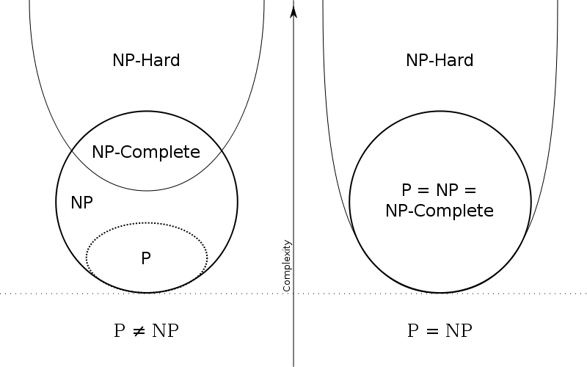
P versus NP problem
Notes:
Prepared by Dr. Zakir H. Ahmed

Slide 28
P versus NP problem
Would you liked to try to prove
p = NP?
Notes:
Prepared by Dr. Zakir H. Ahmed

Slide 29
AI / ML Applications (Discrete)
  Many AI problems can be posed as search
Touring problem (route-finding problem)
Planning
The travelling salesman problem (TSP)
Robot navigation.
Game-playing.
Speech Recognition.
Resource allocation.

Slide 30

Search tree algorithms
Basic idea:
  exploration of state space by generating successors of already-explored states (expanding states)

Slide 31

Implementation: general tree-search
Fringe node - collection of nodes that have been generated but not yet expanded. Each element of a Fringe is leaf node with no successor (shown as bold outlines in tree diagram)

Slide 32
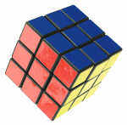
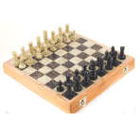
Branching Factors in the search tree
2
1
3
b = branching factor : the number of children at each node. If this value is not uniform, an average branching factor can be calculated.
Examples :
The eight puzzle has a branching factor of 2.13, so a search tree at depth 20 has about 3.7 million nodes. (note that there only 181,400 different states -> 9!/2).
Rubik’s cube has a branching factor of 13.34. There are 901,083,404,981,813,616 different states. The average depth of a solution is about 18. The best time for solving the cube in an official championship was 17.04 sec, achieved by Robert Pergl in the 1983 Czechoslovakian Championship. In 1997 the best AI computer programs took weeks.
Chess has a branching factor of about 35, this means that, on average, a player has about 35 legal moves at his disposal at each turn.
4
7
6
5
8

Slide 33

Implementation: states vs. nodes
A state is a (representation of) a physical configuration
A node is a data structure constituting part of a search tree includes state, parent node, action, path cost g(x), depth
The Expand function creates new nodes, filling in the various fields and using the SuccessorFn of the problem to create the corresponding states.

Slide 34
Search strategies
A search strategy is defined by picking the order of node expansion.
Strategies are evaluated along the following dimensions:
  completeness: does it always find a solution if one exists?
  time complexity: number of nodes generated.
  space complexity: maximum number of nodes in memory.
  optimality: does it always find a least-cost solution?
Time and space complexity are measured in terms of
  b: maximum branching factor of the search tree
  d: depth of the least-cost solution
  m: maximum depth of the state space (may be ∞)

Slide 35
Types of Search Techniques
Uninformed Search Techniques (Blind Search)
Breadth-First Search (BFS)
Uniform Cost Search (UCS)
Depth-First Search (DFS)
Depth Limited Search (DLS)
Iterative Deepening Search
Bi-directional Search
Informed Search Techniques (Heuristic Search)
Hill Climbing (HC)
Best First Search (Best-S)
Beam Search
The A* Algorithm (A-Star)
use only the information available in the problem definition.
generate successors and distinguish a goal state from non-goal state.
strategies that know whether one non-goal state is “more promising” than another or not.

Slide 36
1. Breadth First Search (BFS)
Enqueue nodes in FIFO (first-in, first-out) order.
Intuition: Expand all nodes at depth i before expanding nodes at depth i + 1.
Complete? Yes, if b is finite.
Optimal? Yes, if all step cost are equal.
Time Complexity: O(b^{d+1}), where b is branching factor, d is the depth of the three-search.
Space Complexity: O(b^{d+1}), note that every node in the fringe is kept in the queue.

Slide 37

Breadth-first search
Implementation:
  Fringe is a FIFO queue, i.e., new successors go at end [collection of nodes generated (bold circle) but not yet expanded. Each element of a Fringe is leaf node with no successor]

Slide 38

Breadth-first search
Implementation:
  fringe is a FIFO queue, i.e., new successors go at end

Slide 39

Breadth-first search
Implementation:
  fringe is a FIFO queue, i.e., new successors go at end

Slide 40

Breadth-first search
Implementation:
  fringe is a FIFO queue, i.e., new successors go at end

Slide 41
Properties of breadth-first search
Complete? Yes (if b is finite)
Time? 1+b+b²+b³+… +b^{d} + b(b^{d}-1) = O(b^{d+1}) (as in the worst case last node will be goal which does not need to be expanded)
Space? O(b^{d+1}) (keeps every node in memory)
Optimal? Yes (if costs are equals for all steps)
Space is the bigger problem (more than time).

Slide 42
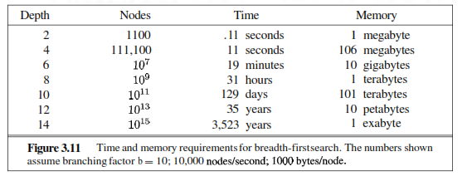
Properties of breadth-first search

Slide 43
3.Depth First Search (DFS)
Enqueue nodes in LIFO (last-in, first-out) order.
Intuition: Expand node at the deepest level (breaking ties left to right).
Complete? No, (Yes, on finite trees, with no loops).
Optimal? No
Time Complexity: O(b^{m}), where m is the maximum depth.
Space Complexity: O(bm), where m is the maximum depth.

Slide 44

Depth-first search
Expand deepest unexpanded node
Implementation:
  fringe = LIFO queue, i.e., put successors at front

Slide 45

Depth-first search
Expand deepest unexpanded node
Implementation:
  fringe = LIFO queue, i.e., put successors at front

Slide 46

Depth-first search
Expand deepest unexpanded node
Implementation:
  fringe = LIFO queue, i.e., put successors at front

Slide 47

Depth-first search
Expand deepest unexpanded node
Implementation:
  fringe = LIFO queue, i.e., put successors at front

Slide 48

Depth-first search
Expand deepest unexpanded node
Implementation:
  fringe = LIFO queue, i.e., put successors at front

Slide 49

Depth-first search
Expand deepest unexpanded node
Implementation:
  fringe = LIFO queue, i.e., put successors at front

Slide 50

Depth-first search
Expand deepest unexpanded node
Implementation:
  fringe = LIFO queue, i.e., put successors at front

Slide 51

Depth-first search
Expand deepest unexpanded node
Implementation:
  fringe = LIFO queue, i.e., put successors at front

Slide 52

Depth-first search
Expand deepest unexpanded node
Implementation:
  fringe = LIFO queue, i.e., put successors at front

Slide 53

Depth-first search
Expand deepest unexpanded node
Implementation:
  fringe = LIFO queue, i.e., put successors at front

Slide 54

Depth-first search
Expand deepest unexpanded node
Implementation:
  fringe = LIFO queue, i.e., put successors at front

Slide 55

Depth-first search
Expand deepest unexpanded node
Implementation:
  fringe = LIFO queue, i.e., put successors at front

Slide 56
Properties of depth-first search
Complete? No: fails in infinite-depth spaces, spaces with loops
  Modify to avoid repeated states along path
    → complete in finite spaces
Time? O(b^{m}) : terrible if m is much larger than d
  but if solutions are dense, may be much faster than breadth-first
Space? O(bm), i.e., linear space!
Optimal? No.

Slide 57
Time and memory requirement in Breadth-first
Depth | Nodes | Time | Memory
0 | 1 | 1 millisec | 100 bytes
2 | 111 | .1 sec | 11 Kb
4 | 11.111 | 11 sec | 1 Mb
6 | 10⁶ | 18 minutes | 111 Mb
8 | 10⁸ | 31 hours | 11 Gb
10 | 10¹⁰ | 128 days | 1 Tb
12 | 10¹² | 35 years | 111 Tb
14 | 10¹⁴ | 3500 years | 11.111 Tb
Assume branching factor b=10; 1000 nodes explored/sec and 100 bytes/node

Slide 58
Time and memory requirement in Depth-first
Depth | Nodes | Time (best case) | Memory
0 | 1 | 1 millisec | 100 bytes
2 | 20 | 0.02 sec | 2 Kb
4 | 40 | 0.04 sec | 4 Kb
6 | 10 * 6 | 0.06 sec | 6 Kb
8 | 10 * 8 | 0.08 sec | 8 Kb
10 | 10 *10 | 0.1 sec | 10 Kb
12 | 10 * 12 | 0.12 sec | 12 Kb
14 | 10 * 14 | 0.14 sec | 14 Kb
Assume branching factor b=10; 1000 nodes explored/sec and 100 bytes/node

Slide 59

Summary of algorithms

Slide 60
Informed search algorithms

Slide 61
Introduction
Heuristic or informed search exploits additional knowledge about the problem that helps to guide search to more promising paths.
A heuristic function, h(n), provides an estimate of the cost of the path from a given node n to the closest goal state. Must be zero if this node represents a goal state.
Example: Straight-line distance from current location to the goal location in a road navigation problem.
Many search problems are NP-complete so in the worst case still have exponential time complexity; however a good heuristic can:
  Find a solution for an average problem efficiently.
  Find a reasonably good but not optimal solution efficiently

Slide 62
Best-first search
Tree search : A search strategy is defined by picking the order of node expansion
Idea: use an evaluation function f(n) for each node
  estimate of "desirability"
  Expand most desirable unexpanded node
Implementation:
Order the nodes in fringe in decreasing order of desirability
Special cases:
  greedy best-first search
  A* search

Slide 63

Romania with step costs in km

Slide 64
Greedy best-first search
Evaluation function f(n) = h(n) (heuristic)
= estimate of cost from n to goal
Greedy best-first search expands the node that appears to be closest to goal
e.g., hSLD(n) = straight-line distance from n to Bucharest

Slide 65

Greedy best-first search example

Slide 66

Greedy best-first search example

Slide 67

Greedy best-first search example

Slide 68

Greedy best-first search example

Slide 69
Properties of greedy best-first search
Complete? No – can get stuck in loops, e.g., Iasi → Neamt → Iasi → Neamt →
Time? O(b^{m}), but a good heuristic can give dramatic improvement. M is the max depth.
Space? O(b^{m}) -- keeps all nodes in memory
Optimal? No

Slide 70
A* search
Idea: avoid expanding paths that are already expensive
Evaluation function f(n) = g(n) + h(n)
g(n) = exact cost so far to reach n
h(n) = estimated cost from n to goal
f(n) = estimated total cost of the cheapest path through n to goal.

Slide 71

A* search example

Slide 72

A* search example

Slide 73

A* search example

Slide 74

A* search example

Slide 75

A* search example

Slide 76

A* search example

Slide 77
Properties A*
For simplicity, we are AVOIDING the proof that A* Tree-Search is optimal
A-Star = Uniform Cost Search + BFS
g(n) is the cost to get to a node.
h(n) is the estimated distance to the goal.
f(n) = g(n) + h(n)
We can think of f(n) as the estimated cost of the cheapest solution that goes through node n.
Note that we can use the general search algorithm we used before. All that we have changed is the queuing strategy.
Complete? Yes, as long as branching factor is always finite and every operator adds cost at least.
Optimal? Yes
Time Complexity: O(b^{m}), where m is remaining steps to goal.
Space Complexity: O(b^{m}), where m is remaining steps to goal.
Searching Methodology

Slide 78
Properties A*
How fast A-Star?
A* is the fastest search algorithm. That is, for any given heuristic, no algorithm can expand fewer nodes than A*.
How fast is it? Depends of the quality of the heuristic.
If the heuristic is useless (i.e: h(n) is hardcoded to equal 0 ), the algorithm degenerates to uniform cost.
If the heuristic is perfect, there is no real search, we just march down the tree to the goal.
Generally we are somewhere in between the two situations above. The time taken depends on the quality of the heuristic.
Searching Methodology

Slide 79
Other Search Algorithms
Other common search algorithms are:
Hill Climbing
Simulated Annealing
Evolutionary / Genetic Algorithms (GA)
We are skipping Hill Climbing and Simulated Annealing algorithms. And moving to GA next.

